Slide 1

Analysis of NYSE Data

Slide 2
What is the mean growth rate of all NYSE Sectors through 2013 to 2015?
Observations(Chosen Metric is Total Revenue):
There is a steep decline in the energy sector from 2% in 2014 to 52% in the year 2015. In addition , it as a highest deviation of 269 billion and a range of 481 billion due to its market fall. Its meaned growth rate for 214 to 2015 is -27%.
Well performing sectors in the market are: Health Care with mean growth rate of 10%, Real Estate of 9%, Consumer Discretionary at 7%, IT and Telecommunications of 6 % and 5 % respectively. These sectors can be a good starting point for diversifying the portfolio for an investor.
The Financials and Real Estate sectors has the lowest standard of deviations at 4.8 billion and 6.2 billion respectively, it implies that their anual earnings are not that far from their average revenues and thus they have stable markets.

Slide 3
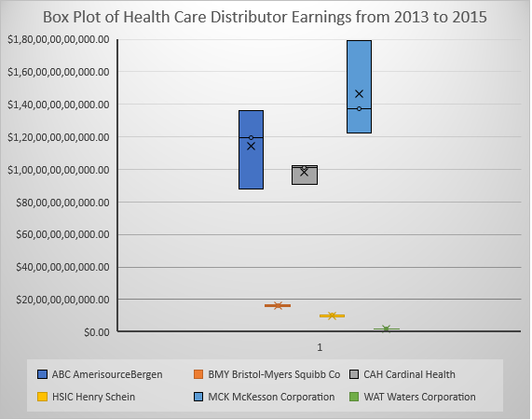
How is spread in the earnings of Health Care Enterprises through 2013 to 2015?
Observing the box plot of earnings of Health Care enterprises through 2013 to 2015, it can be assessed that there is at least 70 billion dollars of revenue that separates half of the companies that is listed in this sub-industry.
MCK (McKesson) posted the highest revenue of 179 billion in 2015. It has a mean growth rate of 17% and has the highest deviation at 29 billions. It can be said that it has good dominance in the market.
AMC (AmerisourceBergen) and CAH are the other two that are much separated from the box plot. Their lowest revenue are 87 billion and 91 billion respectively. Comparing to the three year revenues of BMY Bristol, HSIC Henry Schein and WAT Waters Corp it is not even equal to the summed earnings of the former.
The highest range of revenue for the Health Care enterprises was in 2015 with 177 billion. That is how much McKesson's revenue of 179 billion when subtracted Water's Corporation's revenue of of 2 billion.

